Slide 1
Effective NGO website
Guide to:

Slide 2

Think it through

Slide 3
NGOs depend on funding from governments, foundations, and individuals in order to carry out their mission. But how effective are they at connecting with their audience, eliciting interest, and funding their work? NGOs must create a compelling story that resonates with its audience, which may include funders, government officials, and the recipients of their services. That story is told through the content (words and images) presented across all of their communication channels, and specifically their websites.

Slide 4
NGOs can communicate more effectively with their audiences by implementing some simple strategies around their website
Decide on the scope of the website: visibility, communication, sharing news?
Define and state clearly the CORE message to communicate (Brand Identity)
Define our audience
Develop a simple and effective content strategy
Monitor results and tweak as necessary

Slide 5
Site map and layout

Slide 6

WHAT do we EXPECT TO FIND ON the web site?

Slide 7
ANALYSE YOUR STYLE

Slide 8
Do we already have a brand identity?
We will need it!
Brand Identity - The visible elements of a brand (such as colours, design, logotype, name, symbol) that together identify and distinguish the brand in the consumers' mind.

Slide 9
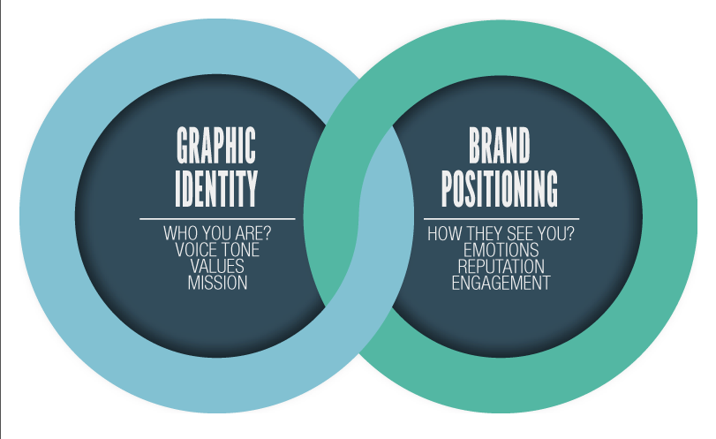
brand identity and brand image
where are we
Consistent Voice and Message brings to quality content and building credibility

Slide 10
ANALYsE key elements

Slide 11
tools and strategies to be used in the near future for website promotion
list of elements to be included for more efficiency
Comments section (do we want the visitors to leave comments? What type of tool we want to use?)
Social Media integration (do we need your visitors to “like” and share your content? Will we integrate a share button?)
Partners and link-building (should we plan a partners page?)
Try and list all those elements to have a clear overview of what will need to be considered when building the site: that’s always easier to plan ahead than to find out in last minute that you really need to integrate a Twitter feed or share content on Social Media

Slide 12
tools
Google analytics
SEO strategy - is it reflected through good website content?
Is the website designed to support easy reading and skimming of contents? Is it User Friendly?

Slide 13

user friendly website
Concise content and readability
Improve navigation
Speed up the site

Slide 14
clear timeline

Slide 15
some examples

Slide 16
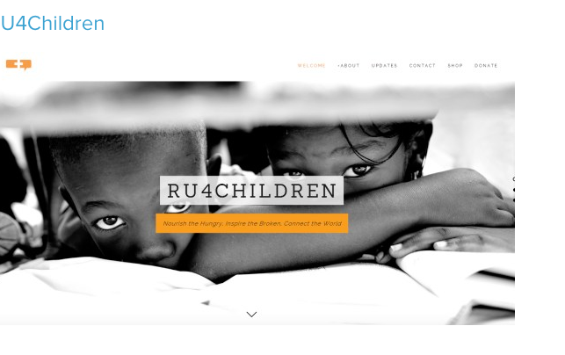
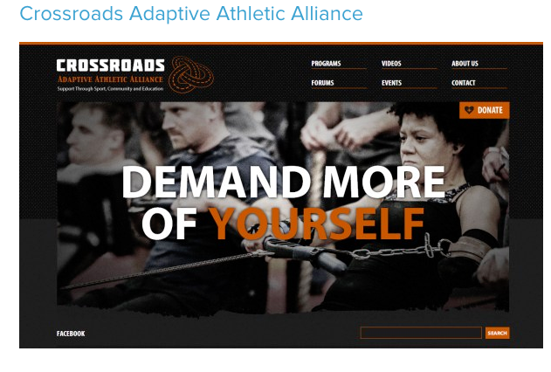
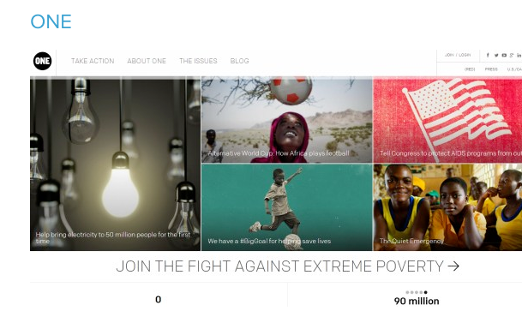
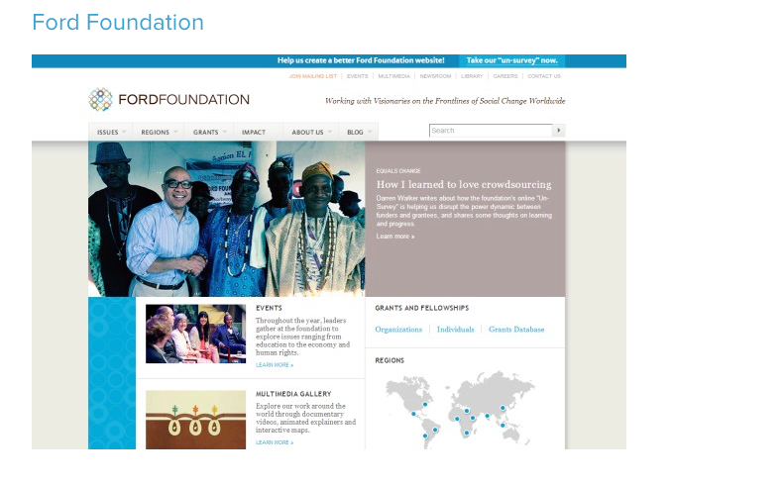

Slide 17
WHY IT WORKS

Slide 18
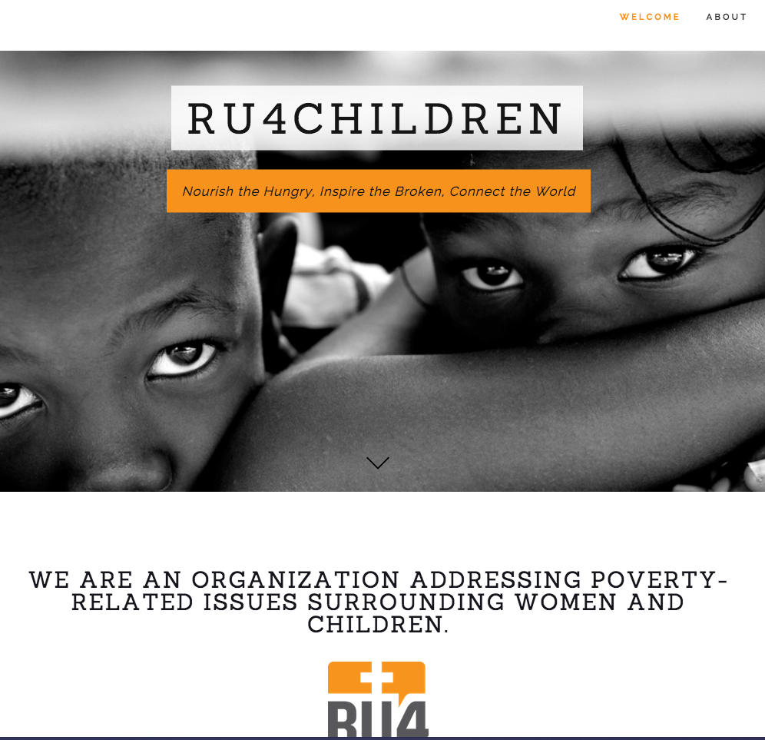
RU4CHILDREN
The homepage provides information about the organization as you scroll down. An arrow is there to let visitors know that they should scroll down and some parallax effects are used.
There are several powerful images of the children being impacted.
Organization information can be found on the “About” page. Donations can also be made through the site.
http://www.ru4children.org/#home

Slide 19
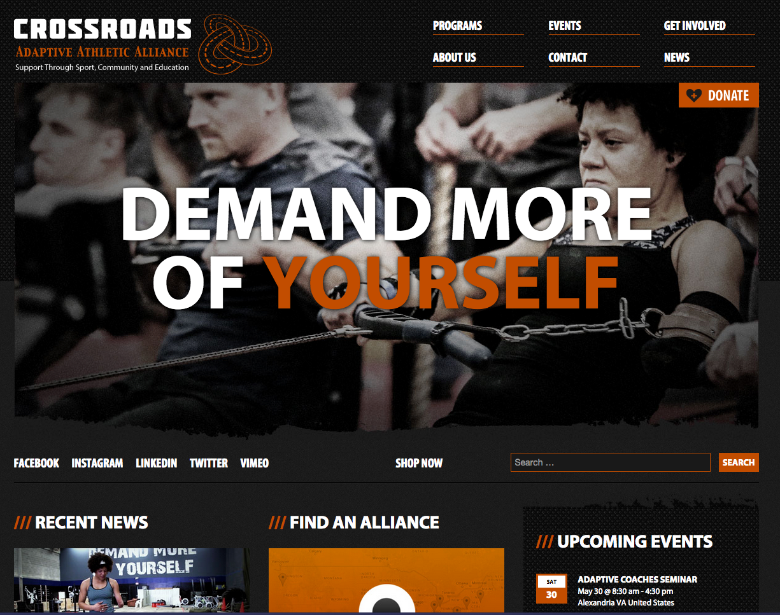
Crossroads adaptive athletic alliance
An organization bio, program information, and upcoming events can be easily found through the navigation menu.
The large photos in the homepage slider show people involved and being impacted by the work of the organization.
There is a “donate” button clearly visible on the homepage.
Videos are also included on the site, and there is even a place to submit your own video.
http://crossroadsalliance.org/

Slide 20
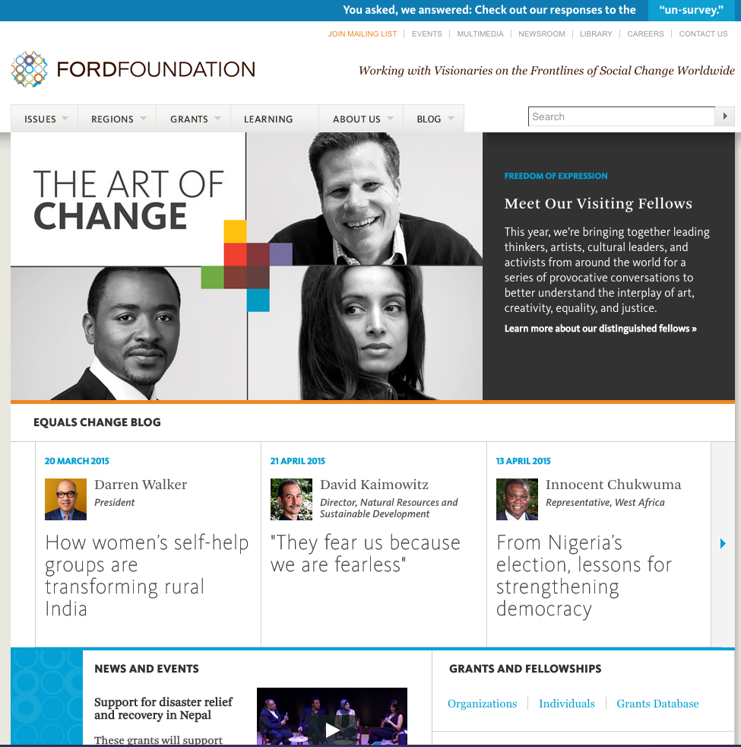
Ford foundation
Scrolling over the “Issues” button opens up a list of the issues and initiatives that are being addressed by the foundation.
The “About Us” link includes all kinds of organization information that visitors will find helpful.
The “Join Mailing List” link in the header is highlighted, which helps the organization to grow a list of people who are interested in their work and allows them to stay in touch.
http://www.fordfoundation.org/

Slide 21
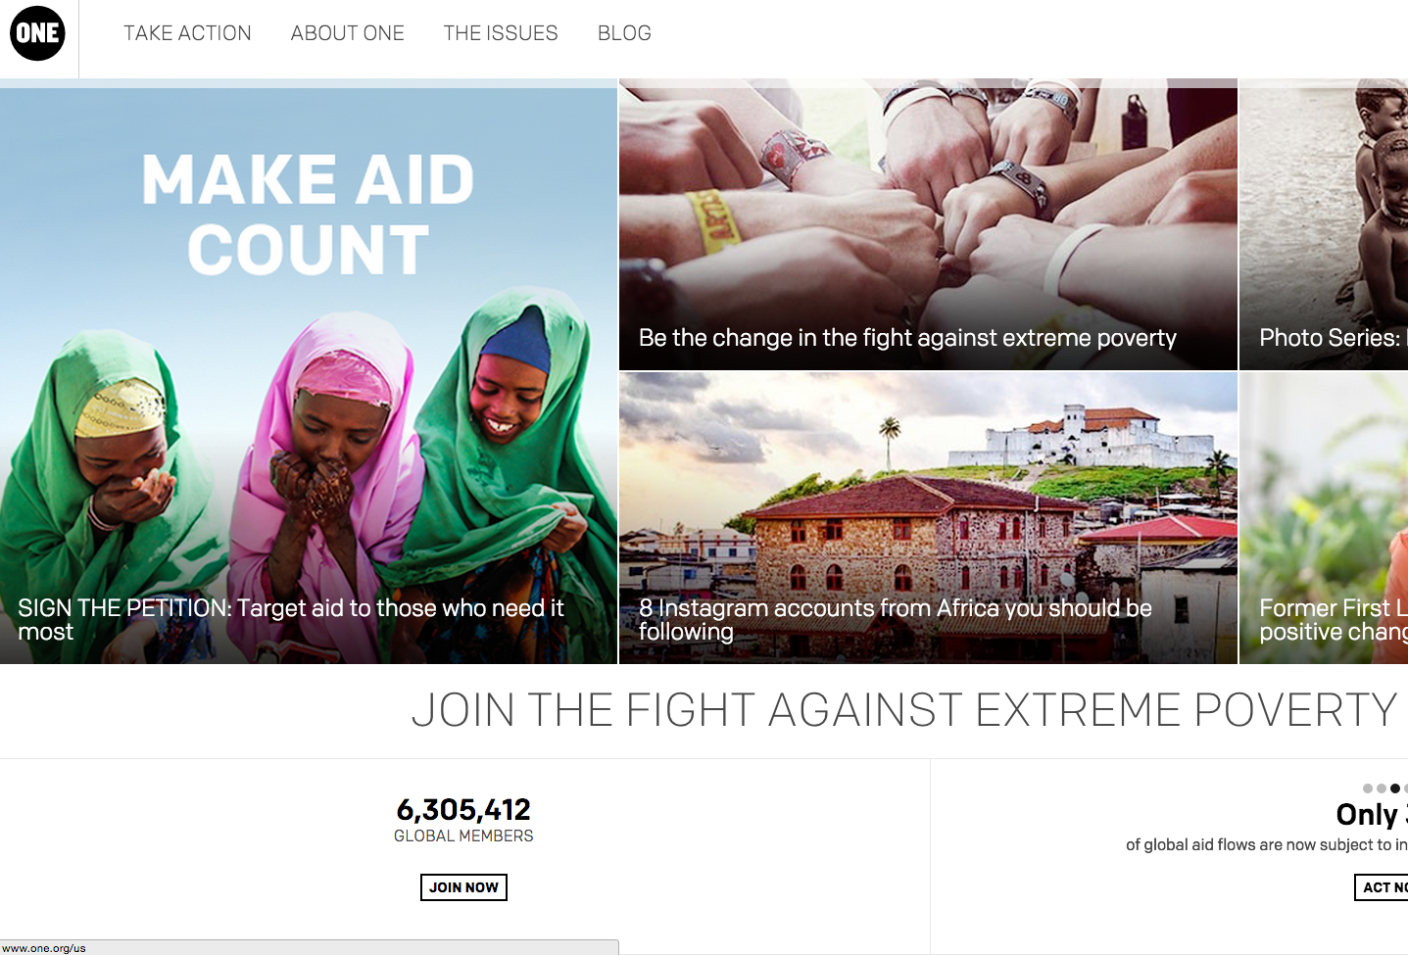
one
The site uses a very clean design style.
The design is responsive, so it looks great on any device or screen.
The “Take Action” link in the navigation menu allows visitors to get involved.
Information about the organization and its purpose can be easily found on the “About ONE” and “The Issues” pages.
http://www.one.org/us/

Slide 22
For NGOs to leverage the web to have the greatest impact, it is critical that they connect with the right audience. It begins with a simple message and is spread through the story of its work and commitment to a culture or cause. An effective website can help any NGO tell its story and enlist the support from its audience.
–civicnations.com

Slide 23
http://www.vandelaydesign.com/best-non-profit-websites/
http://www.pixellar.com/3136/20-best-designed-ngo-websites-sep-2012/

