Slide 1
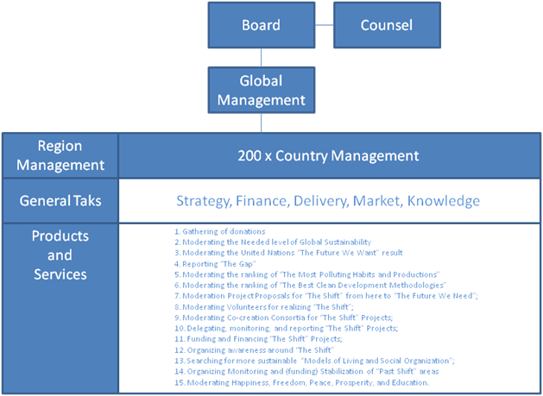

Slide 2
CFO
Board of Control
(Independent)
Chief Sales Officer
ORGANOGRAM
BC
Chief Executive
(President of MT)
Chief Operations Officer
Chief Financial Officer
Chief Knowledge Officer
CEO
MT
CSO
COO
CKO
Outlets
Events
Training
Products

Slide 3
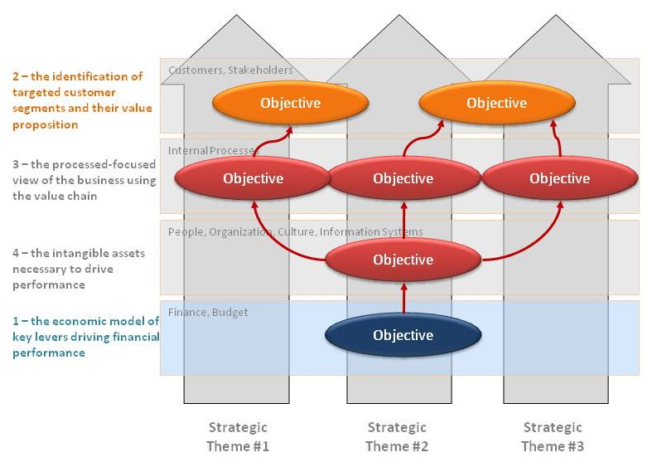

Slide 4
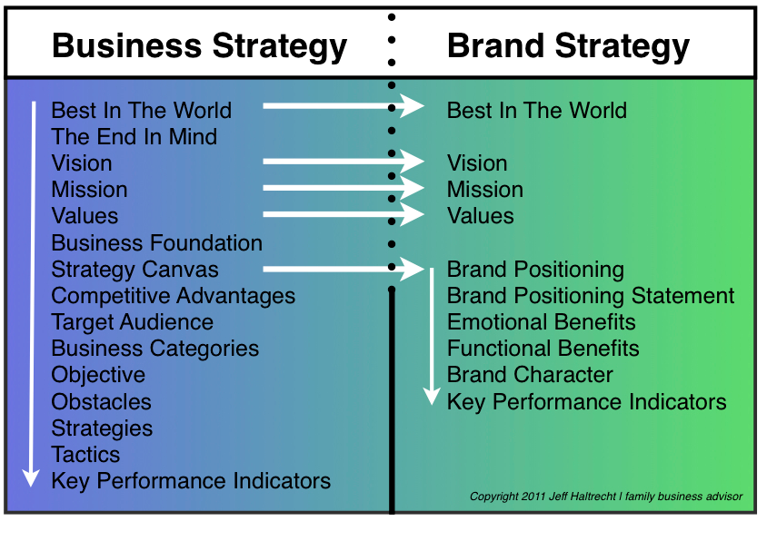

Slide 5
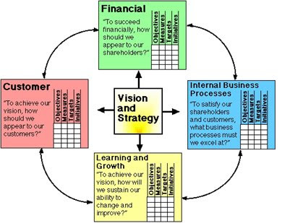
PR, Marketing & Sales
Production & Logistics
HRM & Education

